Slide 1
Max Nav
Domestic/Indoor Navigation System
PROBLEM:
A Lot of navigation apps like Google Maps are available for navigation but none of them support navigation inside a building by taking into account rooms, corridors and floors. The challenge is to create an app that would show a navigation path in the real world on your mobile device screen. This technology is beneficial to everyday citizens because it allows one to accurately navigate to a specific location in a building they have never been to before, such as government offices, a classroom in a campus, malls/retail stores to show customers the items they would want to purchase etc.

Slide 2
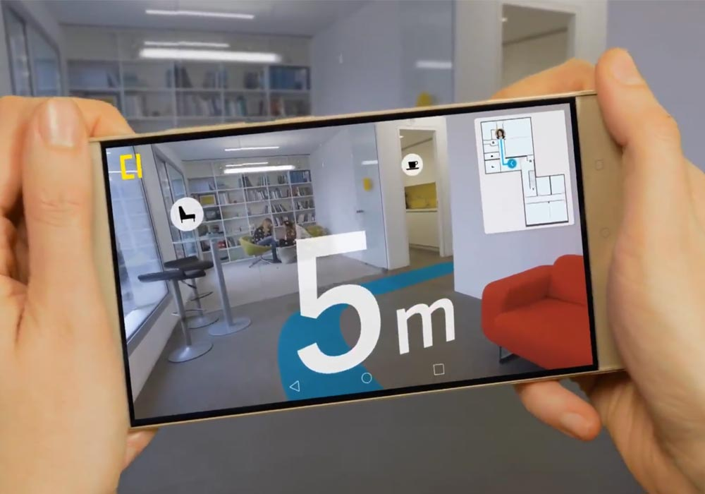
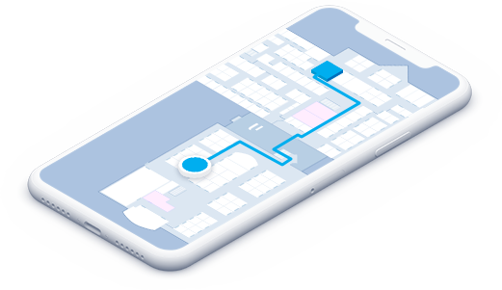






SOLUTION:
Augmented Reality. A Technology that’s not being used in its full potential. We incorporated AR Technology in our application to give immersive guidances through the phone’s camera. The layout of the building is constructed automatically by parameters and sensors such as Pedometer(step counter) and Gyroscope(compass), etc. After the complete generation of the layout, the digital blueprint is fed to the AR module which gives guidance to the user using the camera.
TECHNOLOGY STACK
Front End
XML
Android Studio
AR Core
Sketchup 3D
Platform
Android
Windows 10
Back End
Java

Slide 3
WORKING:
Hassle-Free Layout Creation from fragments of sensor data.
Layout Feeding
AR Guidance on domestic navigation.
Can also be setup to accept pre-existing building drawings.
Step Counter
Layout Uploading
Compass
Building Layout Generation
MAX NAV
Application
Layout Analysis
Augmented Reality Module
3D Conversion
Dependencies
Mobiles must be AR-Compatible
Relative inaccuracy in layouts.

Slide 4

CREATE ACCOUNT
Path Mapping
IMPORT LAYOUT
USER
CONSOLE
USES STEP COUNTER
COMPASS
Augmented Reality output

